Slide 1
Travel & bike bags/packing/ tools/maintenance etc
Taking it to a Professional Level

Slide 2
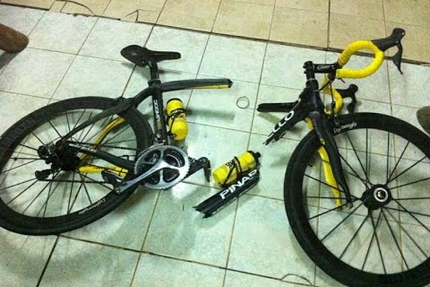
Why?
We need to optimise our operations and make travel easy. It’s a stressor we can minimise if you do it well;
Do it poorly, it will compromise your ability to perform;
Control the controllables and ensure your equipment is at a worlds best standard;
99% right is 100% wrong.

Slide 3
Travel Bags
Carry-on Bag:
Domestic dimensions for most airlines is below with weight not over 7kgs;
Length Height Depth Total linear dimensions
48cm (19in) + 34cm (13in) +23cm (9in) = 105cm (41in)
Soft bag on wheels with retractable handle – easy to wheel around with a bike bag and not carrying too much over your shoulders/back;
Allows you to check in bike bag to 23kgs + your carry on – cheaper (if not free)
Most airlines also permit a laptop bag with your carry on;
Notes:
Use the paper provided to write down your groups ideas.

Slide 4
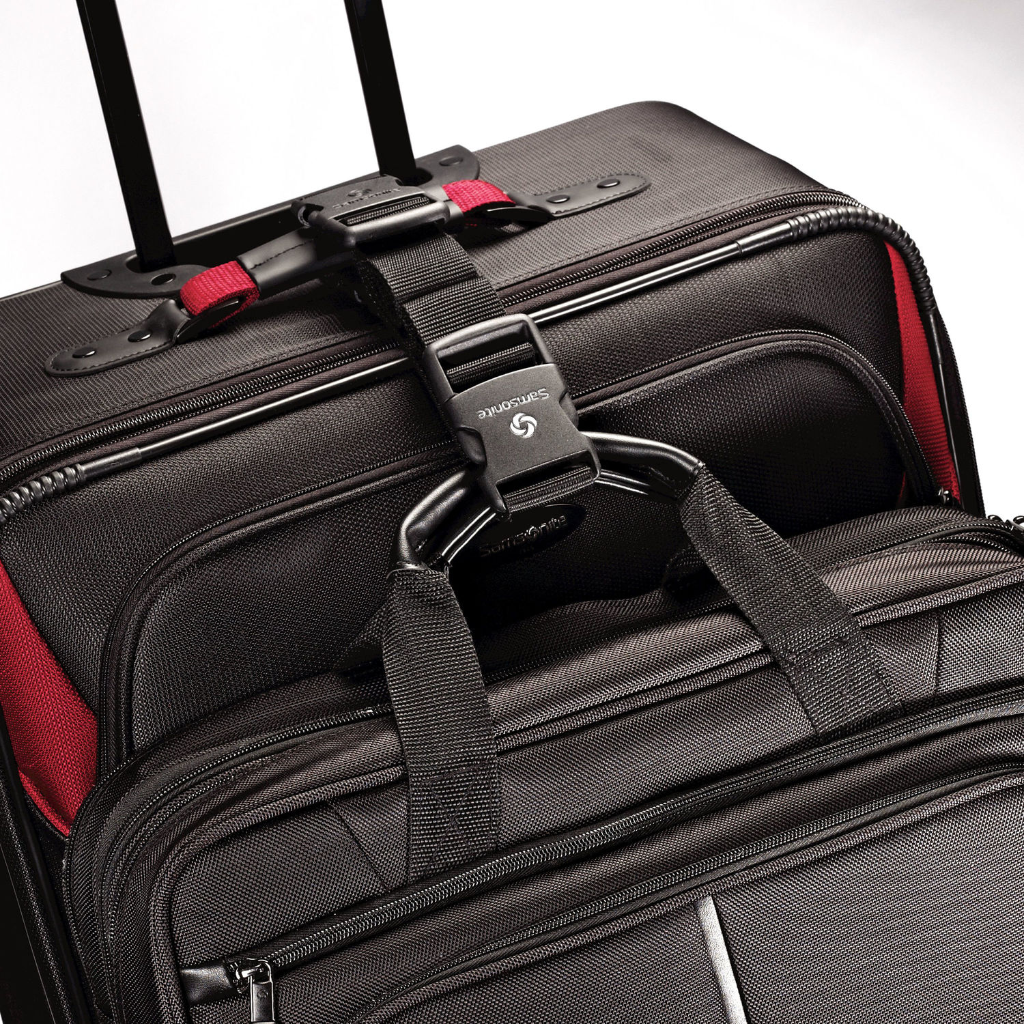
Travel Bags
Main Suitcase/Bag:
On wheels with handle – light and ensure that it can ‘piggy back’ your carry on bag – 3 bags don’t go into 2 hands;
This is an example of what works to piggy back your carry on:
http://shop.samsonite.com/accessories/samsonite-add-a-bag-strap/49493XXXX.html
Bag Straps cost under $10
Notes:
Use the paper provided to write down your groups ideas.

Slide 5
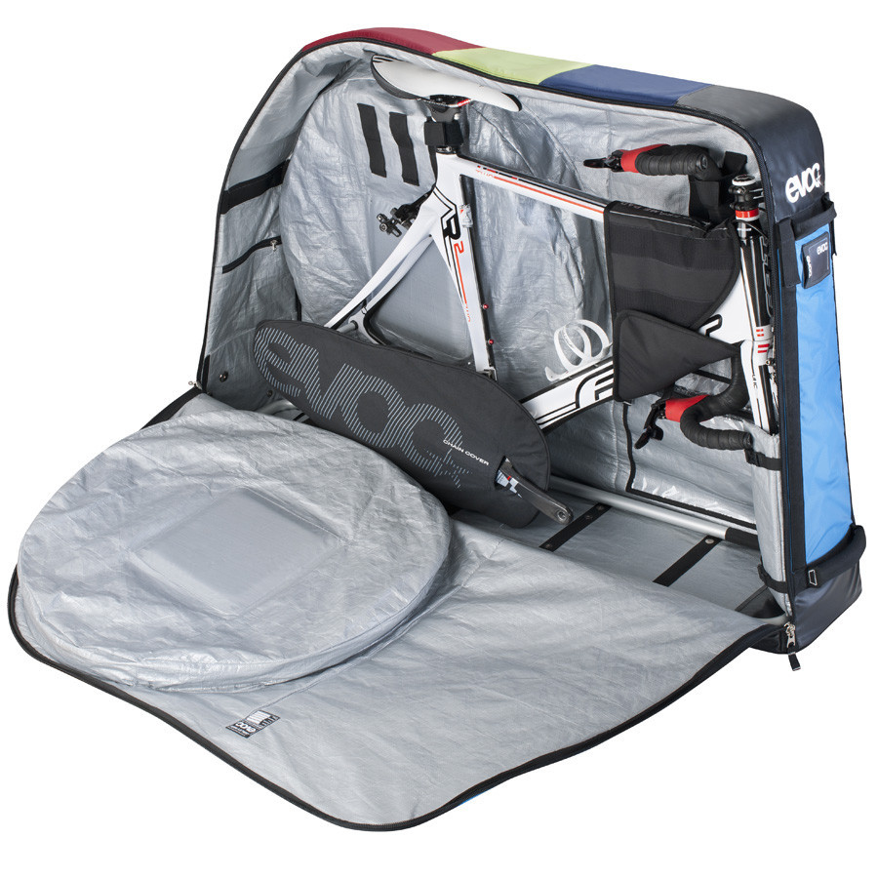
Bike Bags
Bag needs to fit:
1 bike & 2 sets of wheels and some gear;
23kgs or less total weight;
Must fit in cars or vans;
This Evoc style is optimal and many brands are made in this style of bike bag;
https://www.merlincycles.com/evoc-travel-bike-bag-50836.html
Notes:
Use the paper provided to write down your groups ideas.

Slide 6
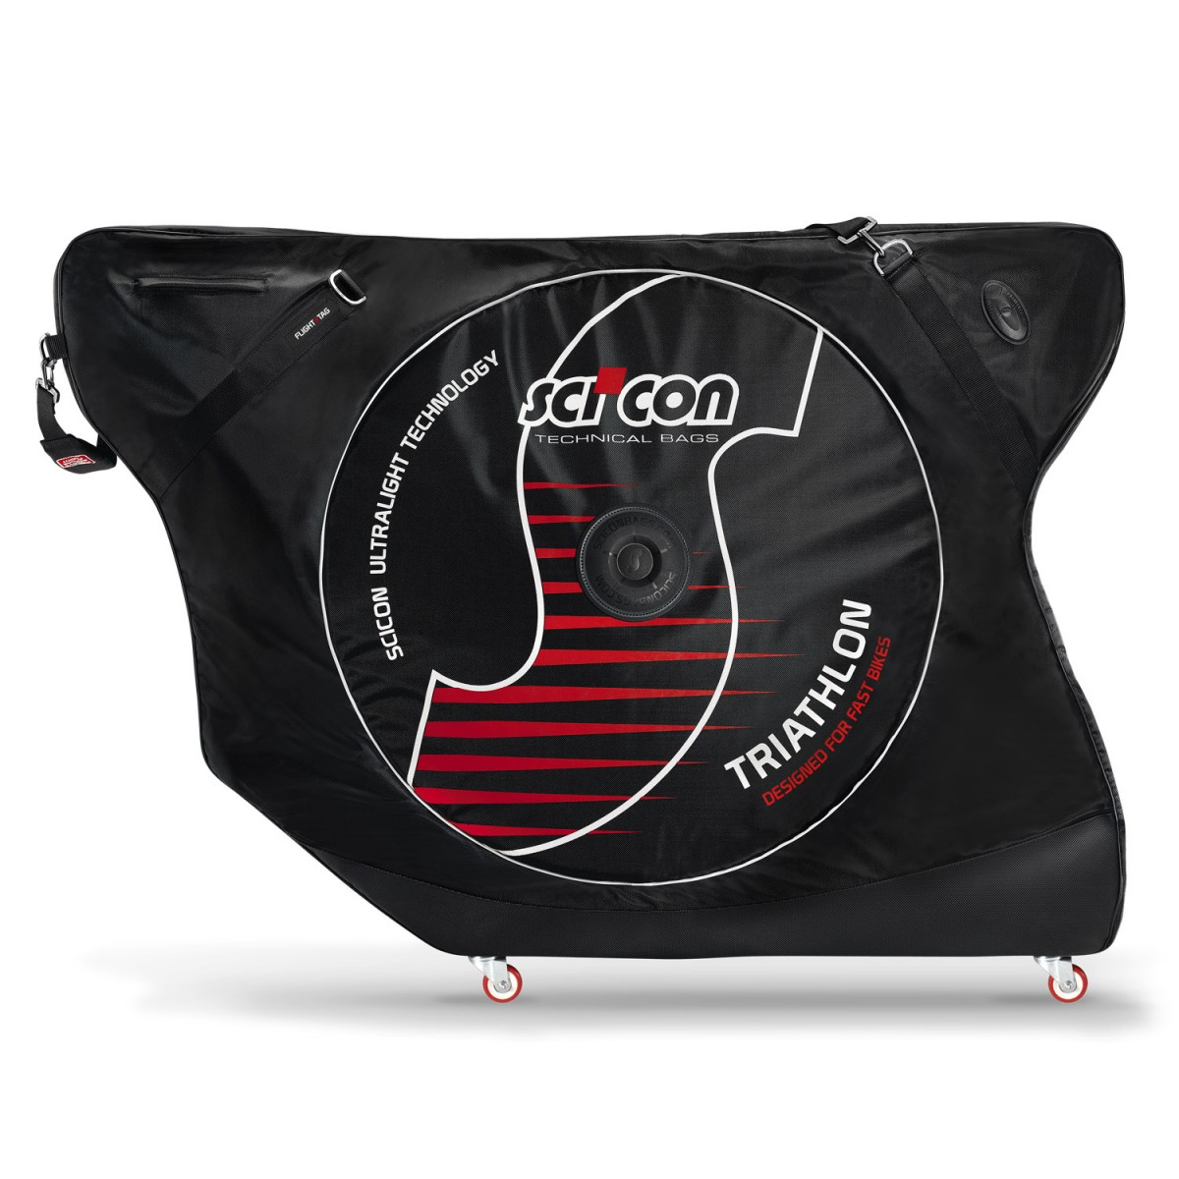
Bike bags
Scicons are an option and whilst much bigger, they allow the bars to stay on – great option for Specialised Venge etc;
http://sciconbags.com
If you cant fit 2 sets of wheels in the bag, its no good.
Notes:
Use the paper provided to write down your groups ideas.

Slide 7
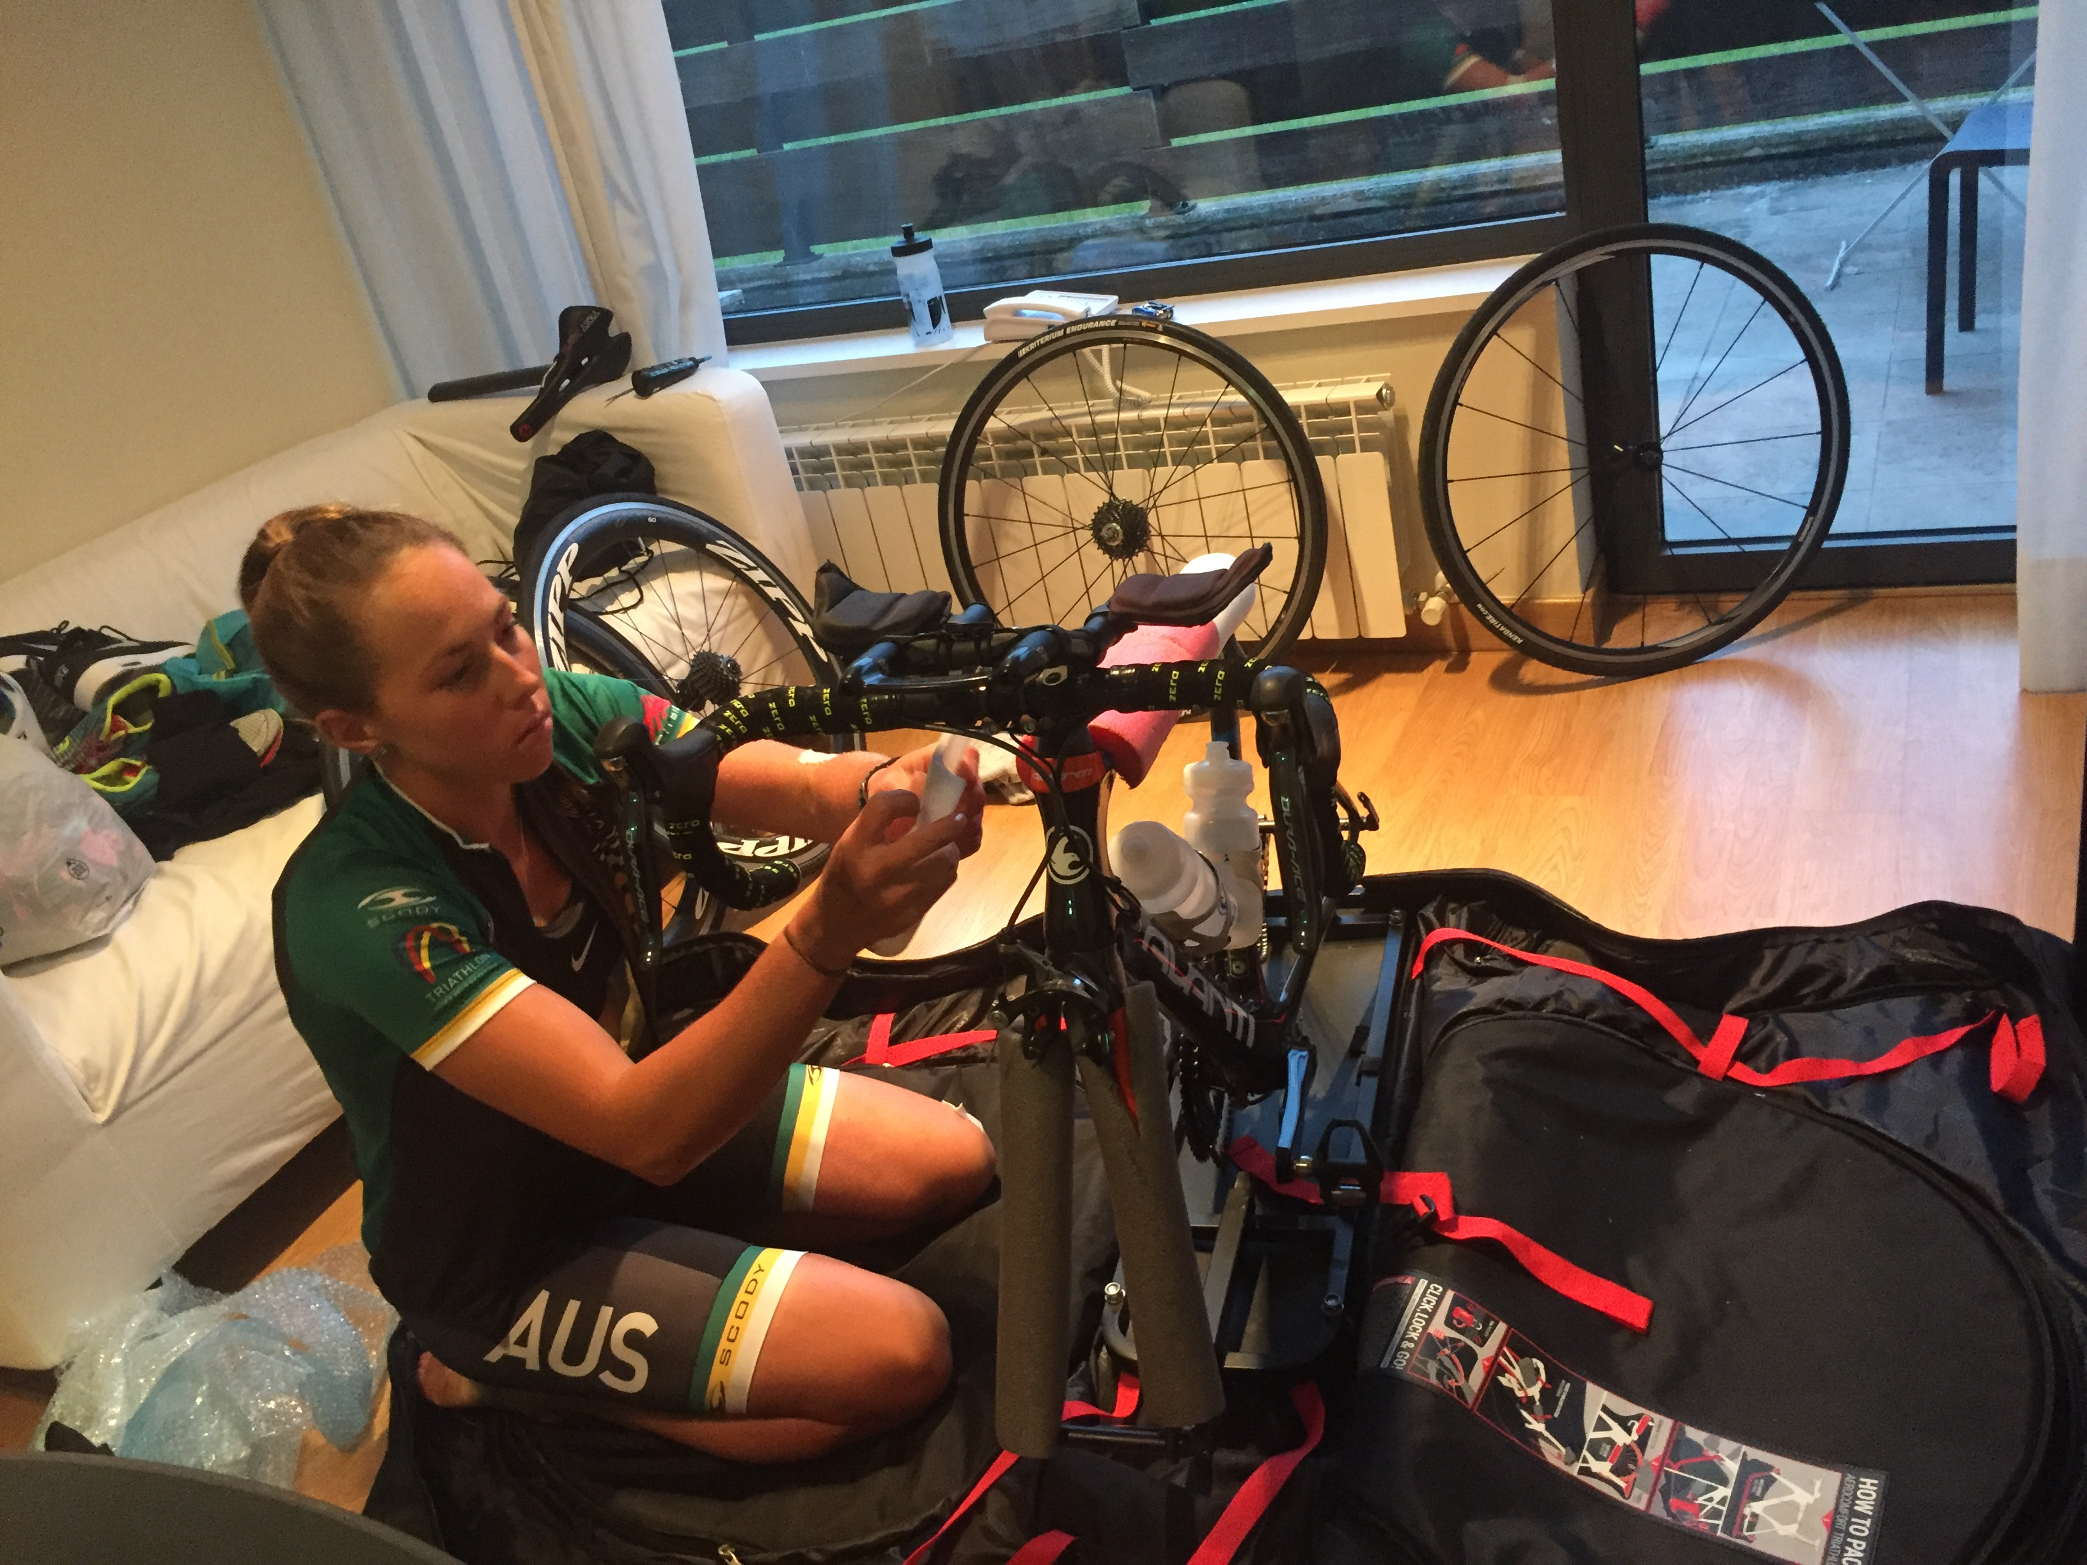
Bike packing
Ensure you have:
Foam tubing to cover all your tubes – no marks need to occur on the bike from travel – use white tubing, its low density (light and full of air) best for absorbing shock;
Large block of foam under chainrings/cranks to absorb impact – extra protection is needed for those on power meters;
Large block of foam around rear tip and rear derailleur area – Your rear derailleur should be OFF

Slide 8
Bike packing
Plugs for the ends of wheel axles and heaps of spare ones as they always go missing and break often - THIS IS THE BIGGEST ISSUE THAT CAUSES TRAVEL DAMAGE - DONT SHIRK ON THIS – get these from your bike shop as they are on new bikes / wheels when shipped from the factories

Slide 9
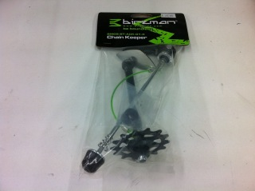
Bike packing
Ensure you have:
Dummy axles/Chainkeeper if required in your bike bag
Something to protect seat pillar and seat - foam tube for example
Wheels in wheel bags
These act as dummy axles (stop the frame from being squeezed) and they keep the chain off the chain stays in travel (save scratches) and they do their best work when you take the rear wheel when cleaning your bike as they allow you to clean the chain, rear mech etc well.
FYI the space at the rear tips is 130mm on a 10/11 speed road bike / 100mm for the front tips

Slide 10
Bike packing
If you have carbon bars or stem or seat pillar –you must use Carbon Paste Athletes overtorque bolts in an attempt to keep components from slipping, this causes snapped bolts, stripped seat clamps, cracked clamps, and crushed seat pillars.
Inserting components dry isn't ideal - seat or bars will slip if you use a grease or oil.
Dry components make noise, corrode, and sometimes slip.
Carbon Paste - Used between carbon/carbon interfaces to reduce the torque required by upwards of 30%. It prevents the seizure of carbon/carbon interfaces.

Slide 11
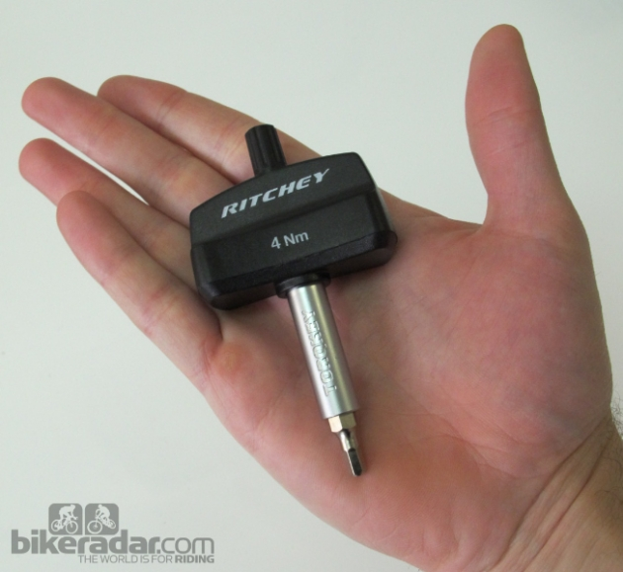
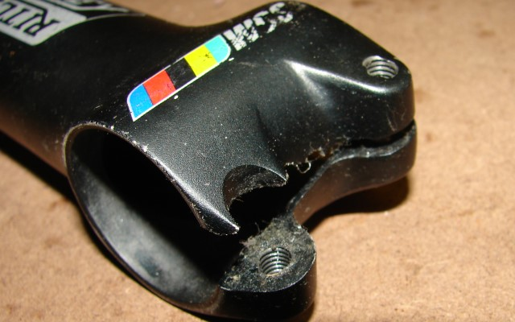
Bike packing
You all need torque wrench for doing up bars - stem and seat clamp with Carbon Paste you can run the max torque and be confident its done up fine - many over tighten seat bolts and bar stems or worse, no uniformity with the torques in multi bolt applications e.g. a bar/stem interface with 4 bolts and you have 1 bolt at 6 N.m. and 1 bolt at 5.5 N.m and 2 bolts at 3 N.m then most of the load is on the 1 bolt at 6N.m - so it has lots of load and you have over tightened it - recipe for trouble - a snapped stem bolt is a DNF if you don't crash in the instant it snaps
The ritchey 4mm torque wrench is a great option for those of you with 4mm stem and seat bolts.
Park Tool has a decent selection of P handle torque wrenches now http://www.parktool.com/category/torque-tools ). - Three pre-sets (4, 5, and 6Nm) and one adjustable (4,4.5,5,5.5,6Nm).

Slide 12
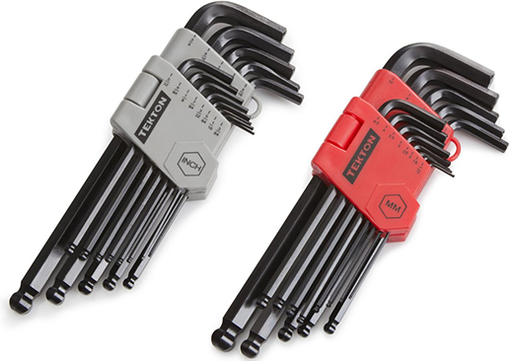
Tools
Multi Tools don't cut it - they are good for back up and for the smaller keys like brake pads etc 3 way Allen keys are best - and backed up with torque wrench to finish off
A 5/6 mm Allen key ("Z" key) is required to tighten rear brake mounts
A set of "L style" Metric Allen keys with Ball End is vital - you will need the smaller ones for brake pad replacement - and the 4/5/6mm for "bigger jobs" - You may not need the bigger ones - i.e. 8mm unless required for your pedals
Ensure you insert tools all the way into bolt heads - to maximize contact area and avoid rounding out bolt heads

Slide 13
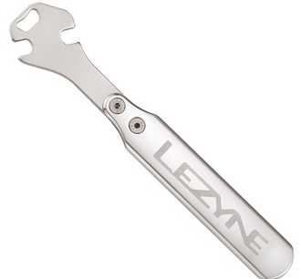
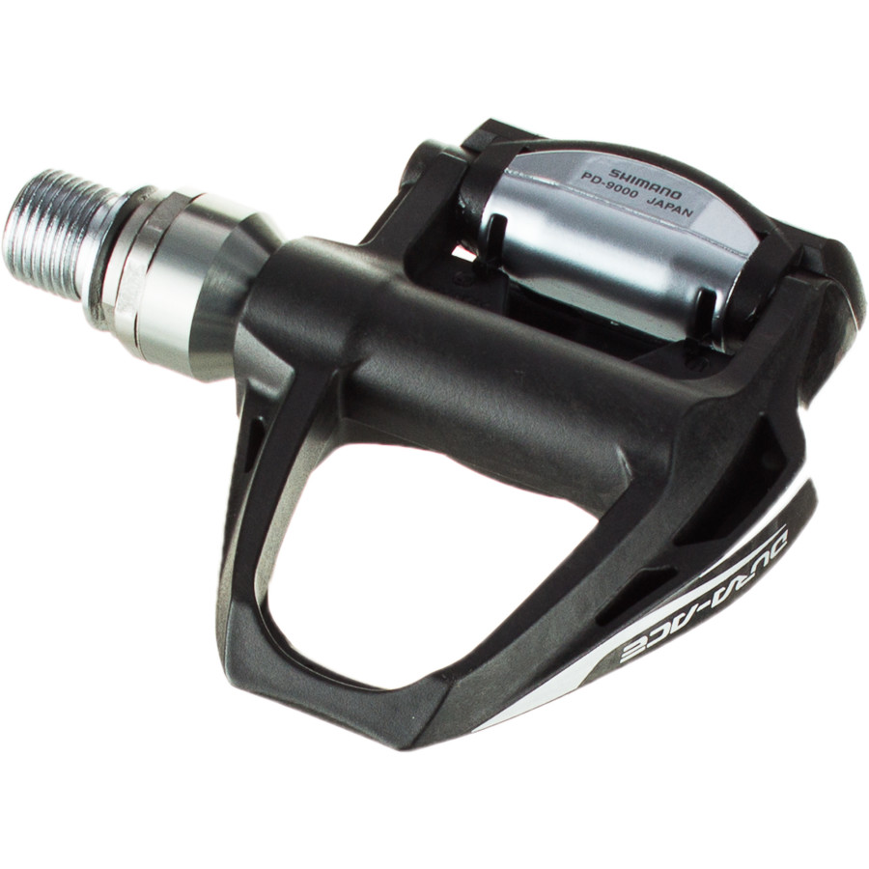
Tools
Ensure your 3 way tool is replaced when worn - the cheaper ones die early you are better off asking for a forged one like Park Tool or the like (rather than the cheaper cast ones)
Pedal Spanner - light and long with quality head - the 2x offset heads are good.
*Don't buy a pedal spanner if you have pedals like this - that only do up with Allen Key inside the axle

Slide 14
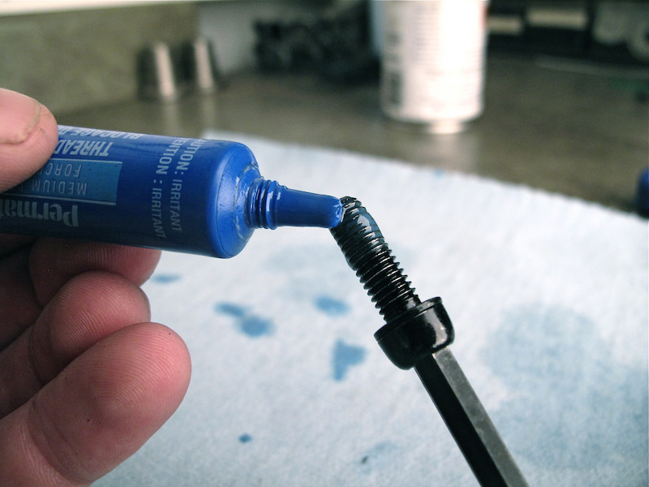
Maintenance
Thread Maintenance
A dry or a dry and dirty thread will let you down
Ensure threads are clean and lubricated - most of your steel bolts do up into softer alloy - dirty and dry threads will bind or grip to the softer thread in the alloy and strip the thread of the alloy – Keep them Clean and Wet
Getting some anti seize thread compound is good - especially for bigger things like pedals - seat clamp bolts - headset bearings - brake bolts
Simply chain oil is great on the smaller bolts you often undo or adjust for packing

Slide 15
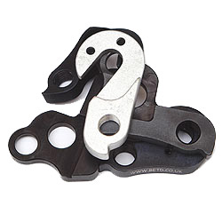
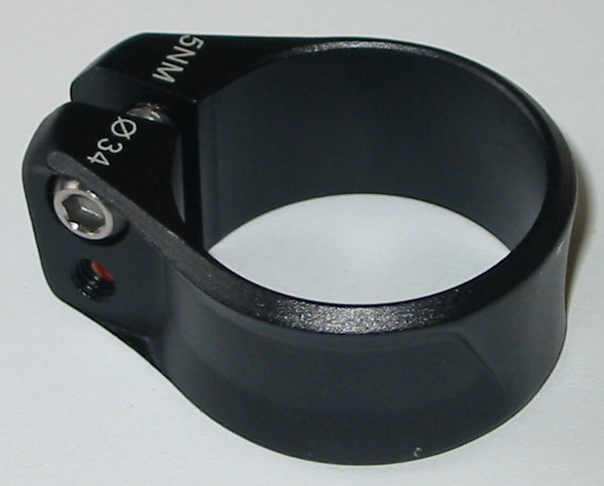
Spare parts
Seat Clamp - you may need a spare one for your bike and the local bike shop may not have the specific brand you need - be prepared
Spare Hangars - and carry some spare mount screws if applicable

Slide 16
Tyres & Wheels
Race day tyres must be 100% - no compromises - don't ride around on race tyres for days pre race – don’t be hopeful or wishful when it comes to tyres !
Take spare wheels to ITU events where wheel stops are in place and to ride pre event;
Ensure you travel with a spare race tyre – whether it be a HP or tubular (If on tubulars ensure you have a tube of fresh unopened glue as opposed a half used tube (and highly oxidized) of glue.
Race wheels should all be using a tyre sealant .... Better do have 30-40ml of this in each tire and have a chance of finishing in your bunch than not having it and having to ride the rim to a wheel stop and then change (its not 100% guaranteed to work but it does work most of the time)

Slide 17
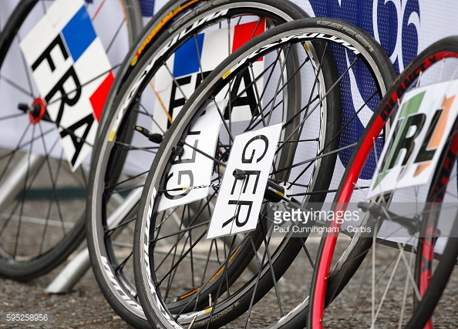
Tyres & Wheels
You need tubes with removable valve cores to use a sealant - or if you are riding tubulars they have removable valve cores …..
Ensure you have wheel cards (sample template attached below - you can print and get laminated - 2 cards on an A4 Landscape) - print up more than you need (3 sets) - you need some strong cloth type tape (white physio tape is good) to attach these to your wheels - ensure you don't place on the cassette side. You need a china-graph pencil to write your race number on and then clean it off for the next time.

Slide 18
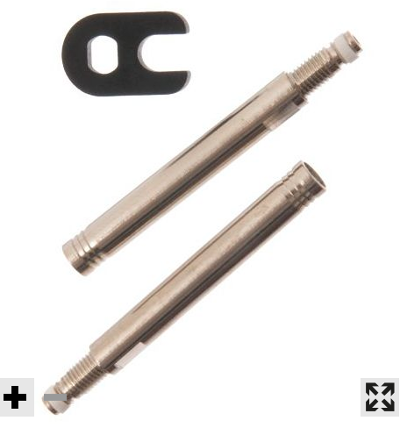
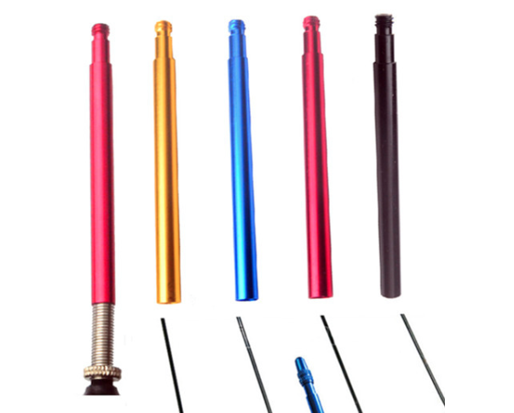
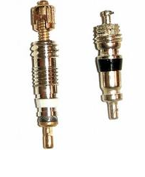
Valves
Internal valve extenders with removable valve cores are the best (and have some spare valves and a valve tool)
Steer away from External valve extenders that thread over the valve. Video description: https://www.youtube.com/watch?v=Sx8aLQBPD-M
Internal valve extenders
External valve extenders
Spare Valves

Slide 19
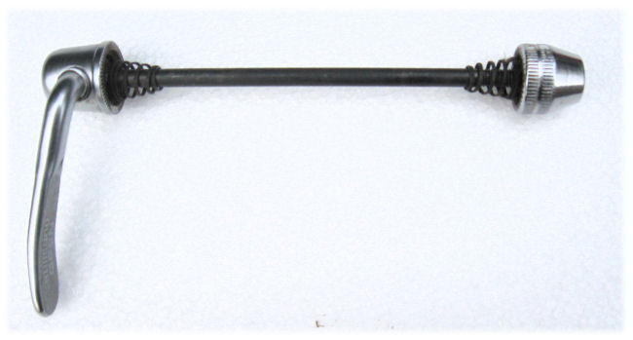
Skewers
Have a read of the article below in order to understand the make up and correct use of skewer
http://sheldonbrown.com/skewers.html

